Slide 1
Data Analysis: Red Bull Account Sales
By: Shubham Trivedi

Slide 2
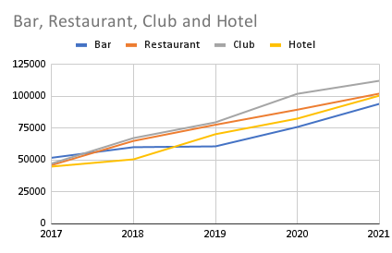
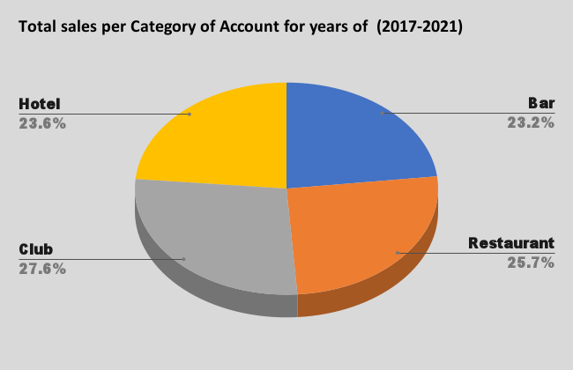
Sales Growth by Account and Account Type
Graph(s) of trends and data for sales by account and / or account type

Slide 3
Best and Worst Performing Accounts by Account Type (5 Year CAGR)
Top 2 Accounts
Bar | Restaurant | Club | Event Venue
Bar 6 | Restaurant 4 | Nightclub 3 | Event Venue 8
Bar 8 | Restaurant 1 | Nightclub 4 | Event Venue 13
Bottom 2 Accounts
Bar | Restaurant | Club | Event Venue
Bar 5 | Restaurant 6 | Nightclub 8 | Event Venue 1
Bar 10 | Restaurant 15 | Nightclub 10 | Event Venue 11

Slide 4
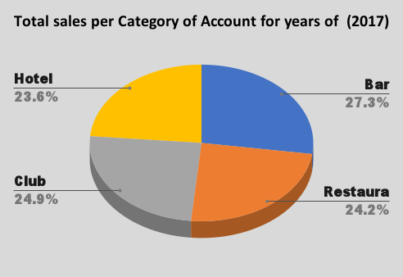
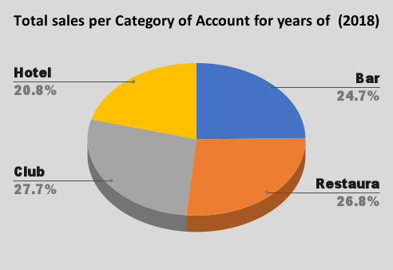
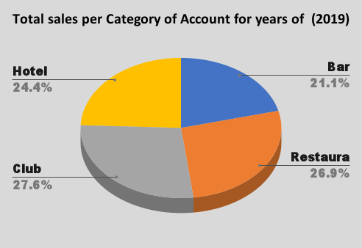
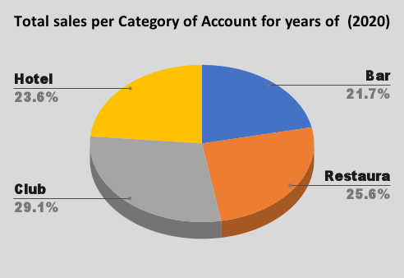
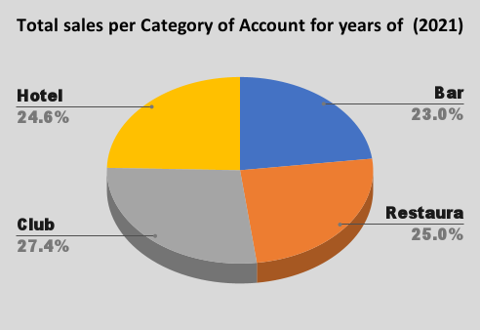
Total Sales by Account Type and Year
Graph(s) of trends and data for total sales by account type and year…

Slide 5
Observations and Key Takeaways
From the sales analysis it was found out that Accounts that are in Club category are bringing the highest amount but to note that there is 2 to 4 percentage of gap in total over other categories
In the year of 2017, Bars were best for business but as years gone by we see growth in businesses in Clubs, Hotels and restraint leaving behind the Bars in the matter of sales, Highest growth being in Clubs.
Best performing Accounts from all accounts are
Worst performing Accounts from all accounts are
Growth of Sales in every Category over five years can be seen as follows:
Restaurant 4 | 39413
Nightclub 3 | 39331
Event Venue 1 | 10574
Event Venue 11 | 8676
Category | Growth
Bars | -4.3%
Restaurant | +1.8%
Clubs | +2.5%
Hotels | +1%

Slide 6
Thank you

